Slide 1
MALIGNANT COMMENTS CLASSIFIER
IBRAHIM A. SHUKOOR
INTERNSHIP – 30

Slide 2
INDEX
INTRODUCTION
DATA PREPROCESSING
EDA & VISUALIZATIONS
MODEL SELECTION
SUMMARY

Slide 3
INTRODUCTION
Thousands of new users are regularly shown signing into their accounts, posting comments on posts, or responding to the comments posted by other users as the social media landscape expands. Users are given the opportunity to openly share their opinions, even if they are occasionally not expressed in the kindest manner. The objective of today's project is to create a model that can determine whether user comments are malicious.

Slide 4
DATA PRE-PROCESSING
The “ID” column was dropped due to the column containing various unique values.
Created a column called “Extreme”, which containing binary values (0/1).
Emails websites, currencies, phone numbers were replaced with something concise to maintain confidentiality and to reduce data uniqueness.
Cleaned additional things such as trailing and leading white spaces, removes words that are made of two letters, removed stop words.

Slide 5
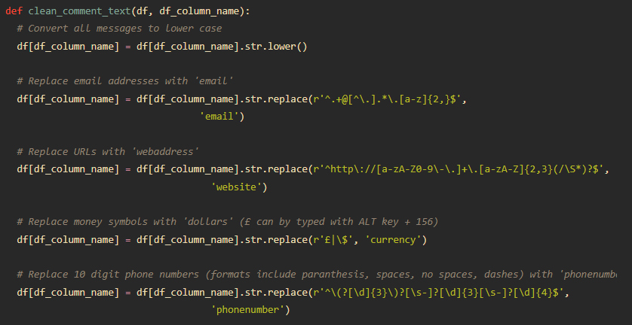
DATA PRE-PROCESSING
Fig 1: snippet of the comment cleaning code

Slide 6
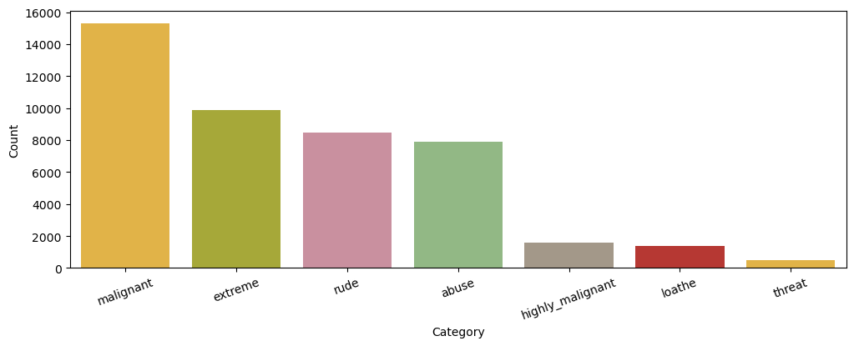
EDA & VISUALIZATION
Category | Count
Malignant | 15294
Highly malignant | 1595
Rude | 8449
Threat | 478
Abuse | 7877
Loathe | 1405
Extreme | 9865
Fig 2: count of the malicious words detected in each category

Slide 7
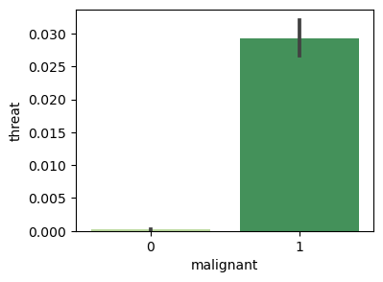
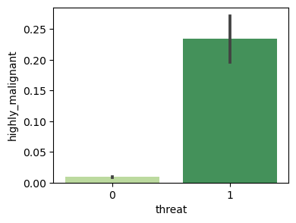
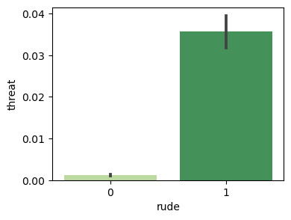

EDA & VISUALIZATION
Fig 3: comparison of malicious words with each category

Slide 8
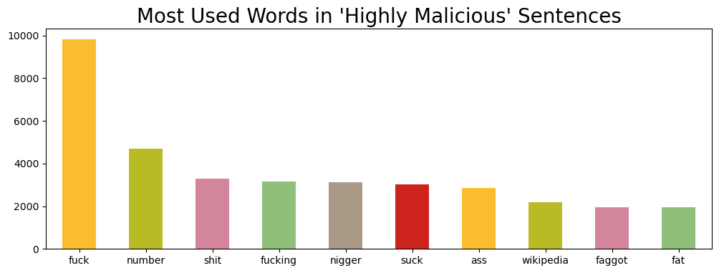
EDA & VISUALIZATION
Fig 4: most used words in “extremely malicious” sentences

Slide 9
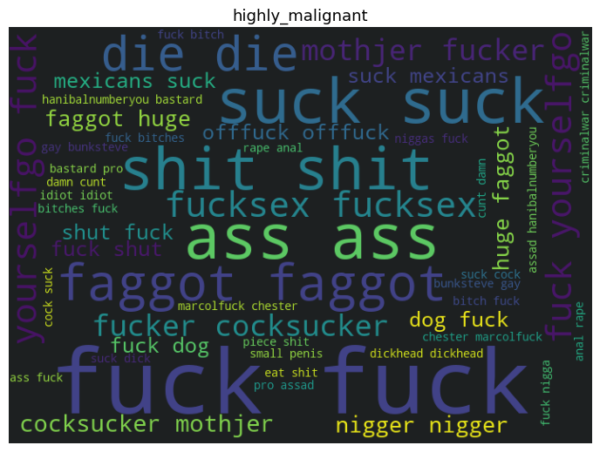
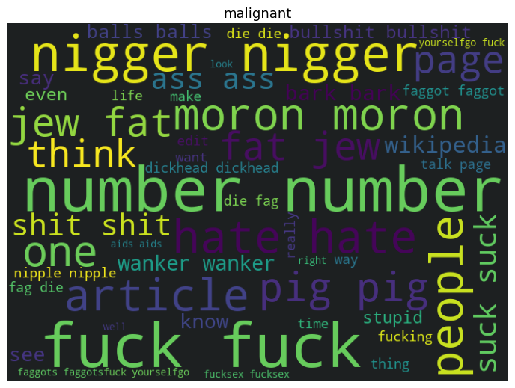
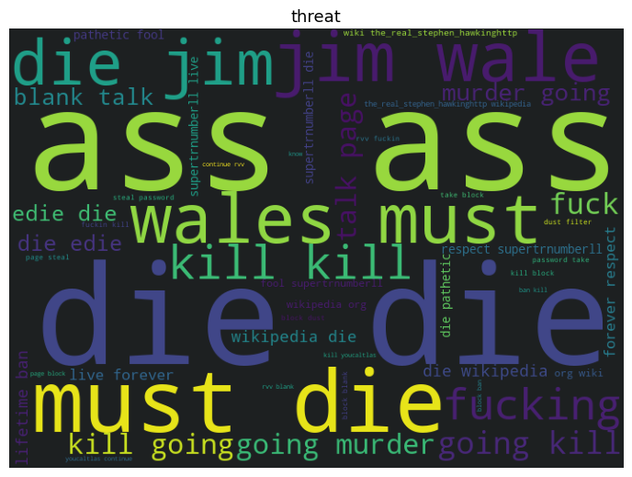
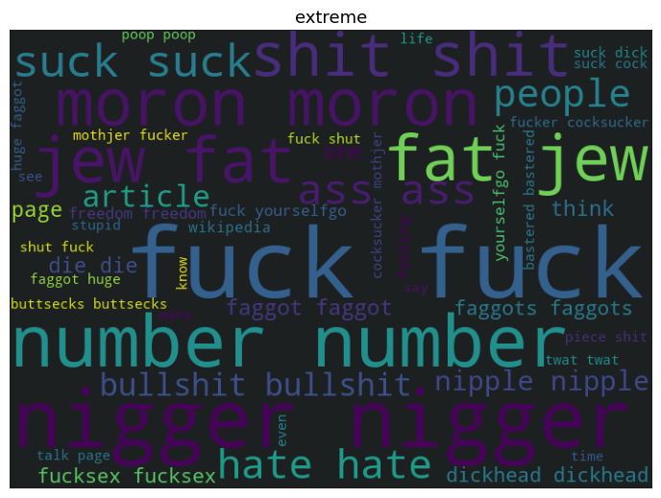
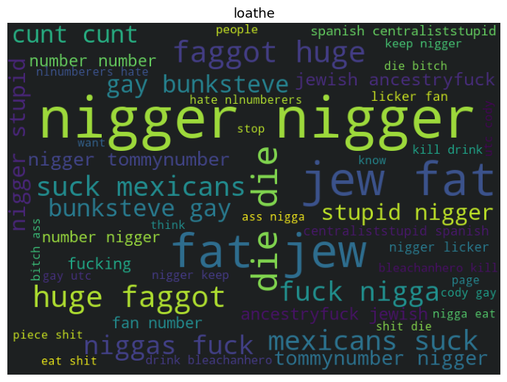
EDA & VISUALIZATION
Fig 5: word-clouds

Slide 10
MODEL SELECTION
5 machine learning models were tested and 1 model was selected based on the performance metrics (Accuracy, F1 Score).
K Neighbors Classifier
Multinomial Naive Bayes (BEST MODEL)
Linear Support Vector Classifier
Logistic Regression
Decision Tree Classifier

Slide 11
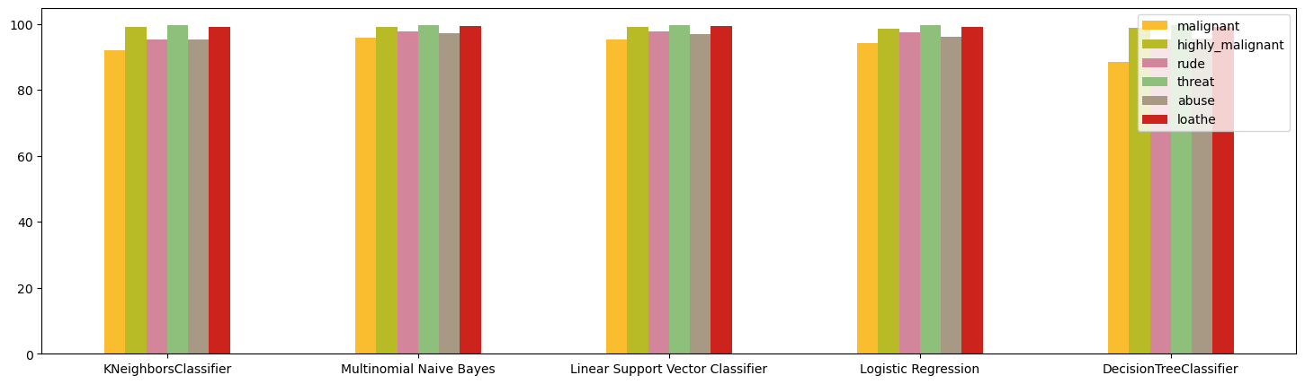
MODEL SELECTION
96.783%
98.126%
98.0%
97.481%
96.178%
Fig 6: Accuracy of the models (bar-chart)

Slide 12
MODEL SELECTION
Additional data on the performance of Multinomial Naive Bayes Classifier.
malignant
Accuracy :: 92.14%
F1 Score :: 32.45%
[[43205 2]
[ 3761 904]]
highly-malignant
Accuracy :: 98.96%
F1 Score :: 0.0%
[[47376 0]
[ 496 0]]
rude
Accuracy :: 95.36%
F1 Score :: 23.63%
[[45305 5]
[ 2218 344]]
threat
Accuracy :: 99.73%
F1 Score :: 0.0%
[[47743 0]
[ 129 0]]
abuse
Accuracy :: 95.35%
F1 Score :: 11.59%
[[45498 6]
[ 2222 146]]
loathe
Accuracy :: 99.16%
F1 Score :: 0.0%
[[47471 0]
[ 401 0]]

Slide 13
SUMMARY
Additional data on the performance of Multinomial Naive Bayes Classifier. A model that successfully distinguished comments including threats, loathe, rudeness, malicious & highly malicious comments have been identified with 98% accuracy. The test data were predicted using this model. This model if integrated successful could be used to identify malicious comments in any social media platform.

Slide 14
THE END♥

